Slide 1
Introduction
DSC – Class – 1.1

Slide 2




Example
Wage | Age | Edu | Exp | Gender
3 | 20 | 11 | 2 | M
Wage | Age | Edu | Exp | Gender
3.24 | 39 | 12 | 22 | F
Wage | Age | Edu | Exp | Gender
5 | 24 | 12 | 5 | F
Wage | Age | Edu | Exp | Gender
11.25 | 38 | 18 | 15 | M
Wage | Age | Edu | Exp | Gender
??? | 30 | 16 | 9 | M
Wage | Age | Edu | Exp | Gender
??? | 37 | 12 | 10 | F

Slide 3
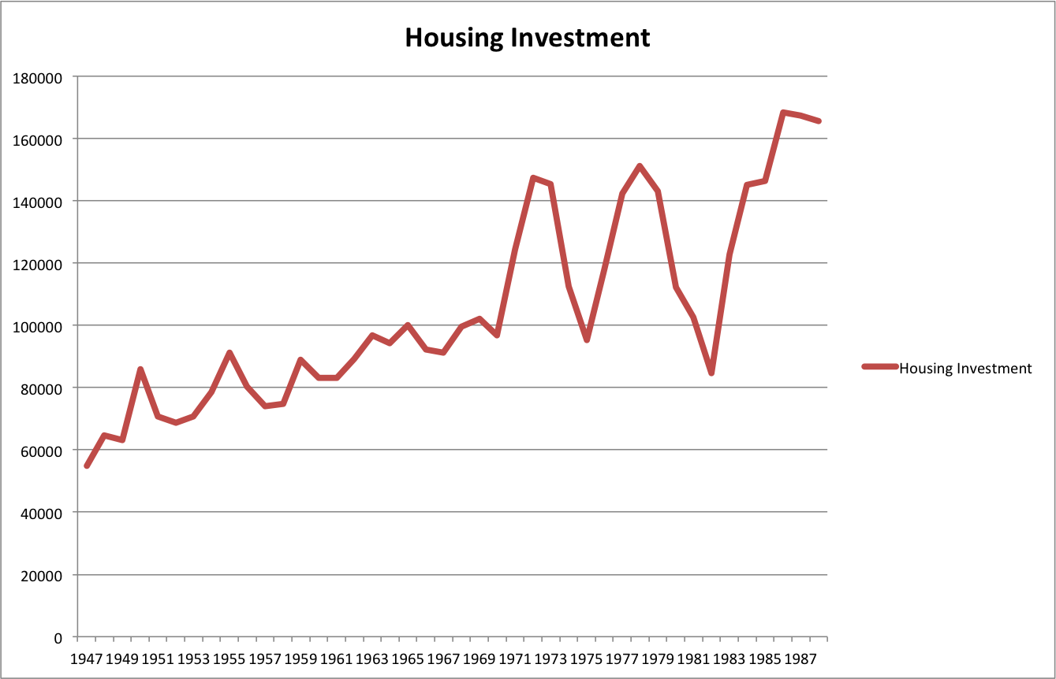
Example
How much we can invest in house in next few years?

Slide 4
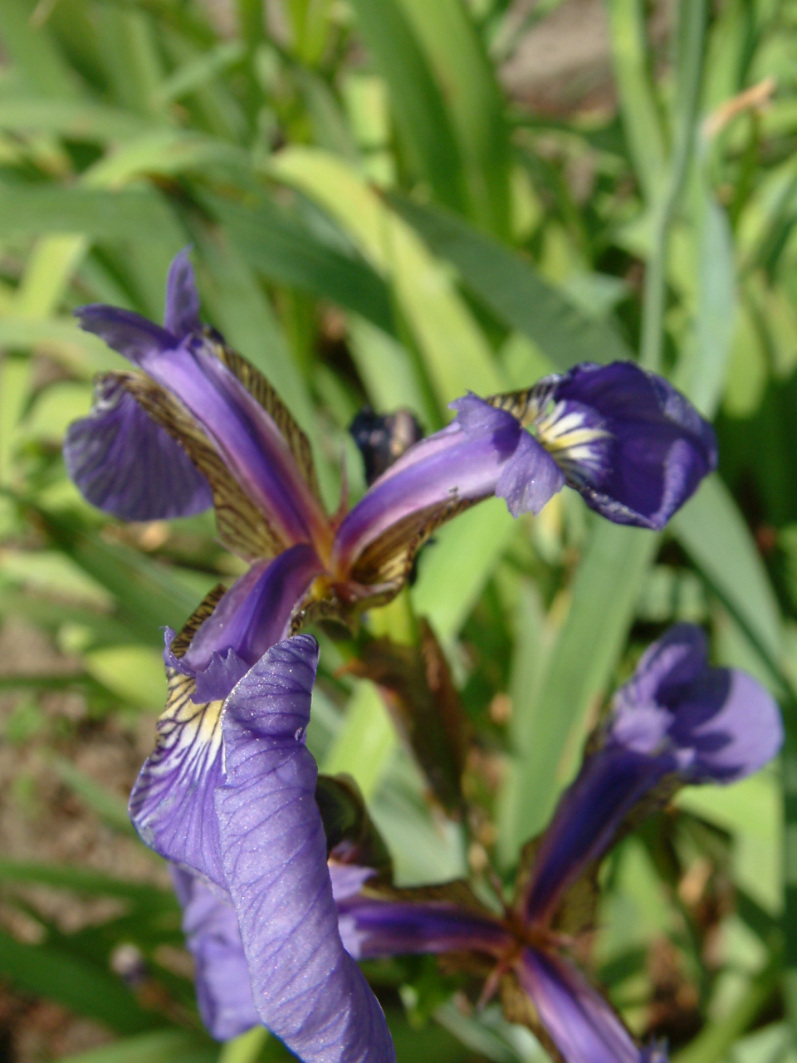
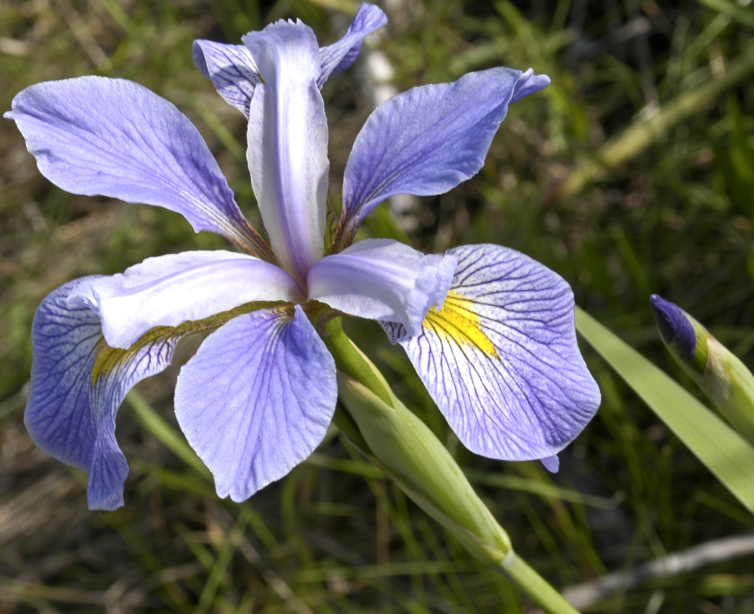
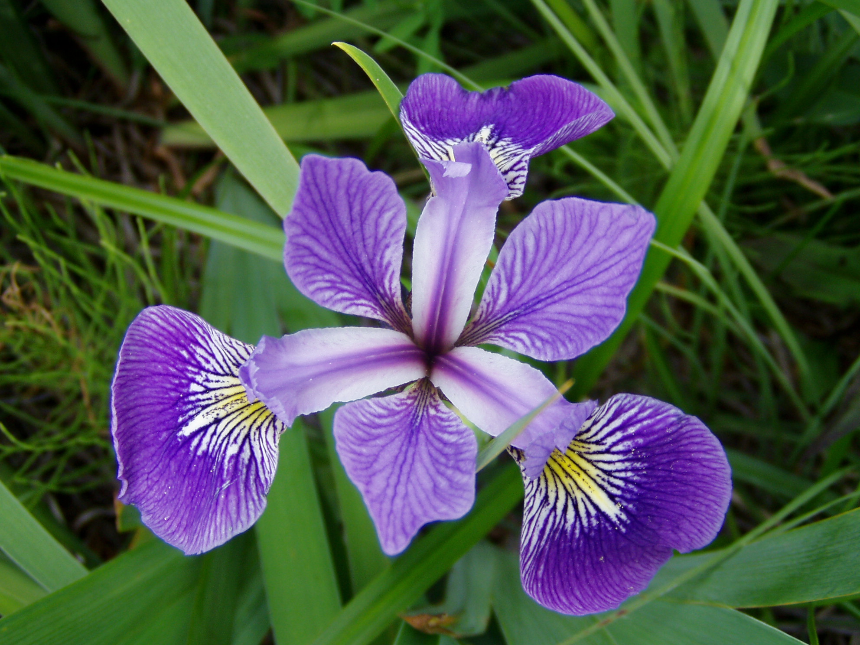
Example
Setosa
Virginica
Versicolor
Features?
Sepal length
Sepal width
Petal length
Petal width

Slide 5
Example
Consider the same example but without the labels
Features?
Sepal length
Sepal width
Petal length
Petal width

Slide 6
Question
What is most important thing for all the above problems?
Features

Slide 7
Data Reduction
How will you handle, if you have too many features?
Too many features
Reduced features
Techniques
Very less information loss

Slide 8
Terminology
Regression
Time Series Analysis
Classification
Clustering
Data Reduction Techniques
Any major difference among above examples?

Slide 9
Types of learning
Supervised Learning
Regression
Classification
Unsupervised Learning
Clustering
Data Reduction Techniques
Time Series Analysis

Slide 10
Key Takeaways?
Task: Write two lines in your words for each of the above technique

Slide 11
Q & A

